Slide 1
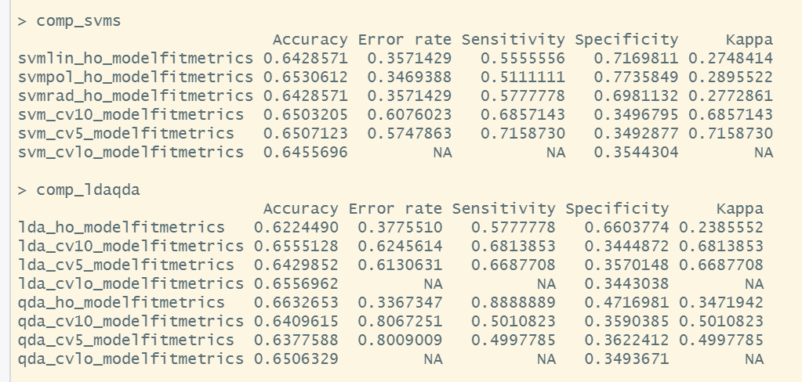
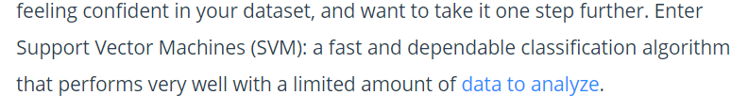
Results IV: SVM
An Introduction to Support Vector Machines (SVM) (monkeylearn.com)

